Slide 1
Principal component analysis (pca)

Slide 2

PCA
Principal Component Analysis (PCA) is a linear dimensionality reduction technique that can be utilized for extracting information from a high-dimensional space by projecting it into a lower-dimensional sub-space.
Applied in Data visualization.

Slide 3
Dimensionality reduction
Dimensionality reduction, or dimension reduction, is the transformation of data from a high-dimensional space into a low-dimensional space so that the low-dimensional representation retains some meaningful properties of the original data, ideally close to its intrinsic dimension.

Slide 4
Example 1
Housing data:
Size
Number of rooms
Number of bathrooms
Schools around
Crime Rate

Slide 5
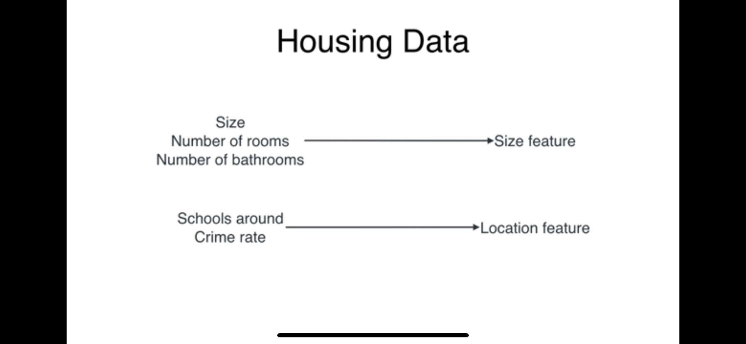
Housing data

Slide 6
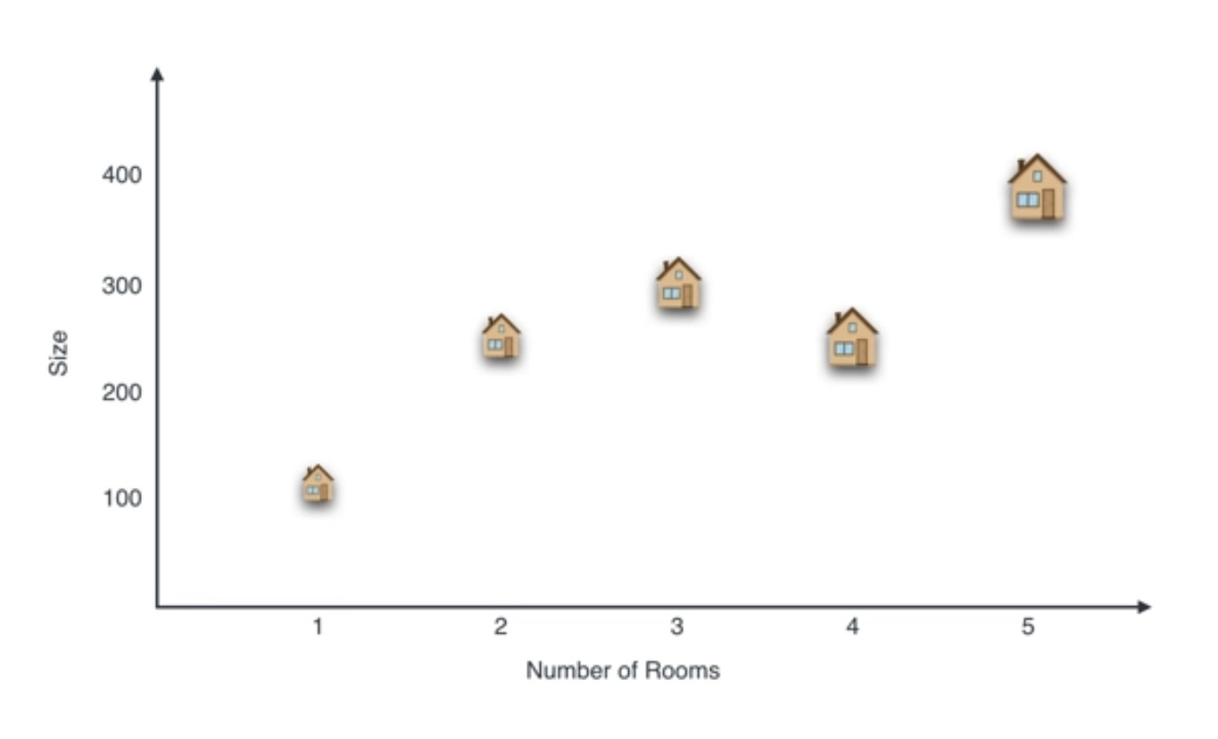

Slide 7
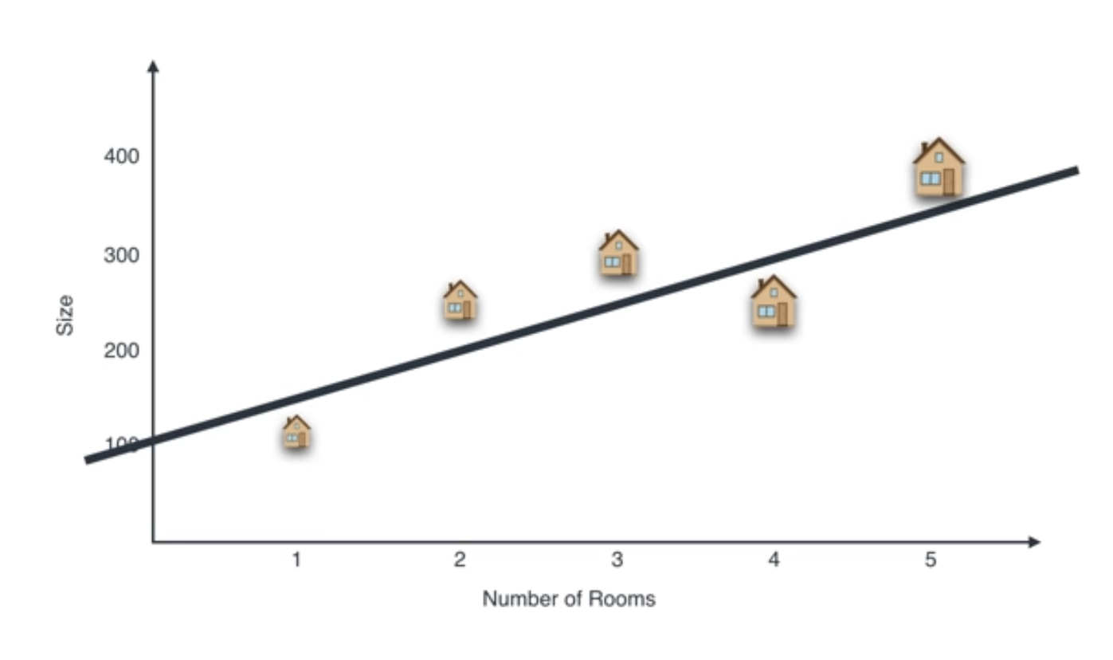

Slide 8
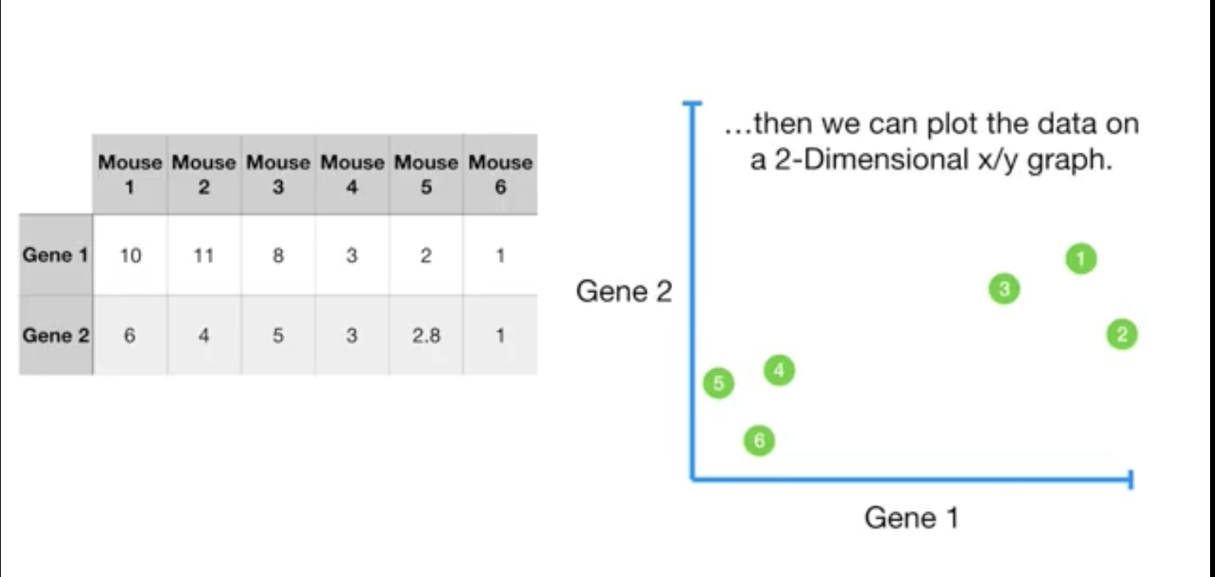
Example 2

Slide 9
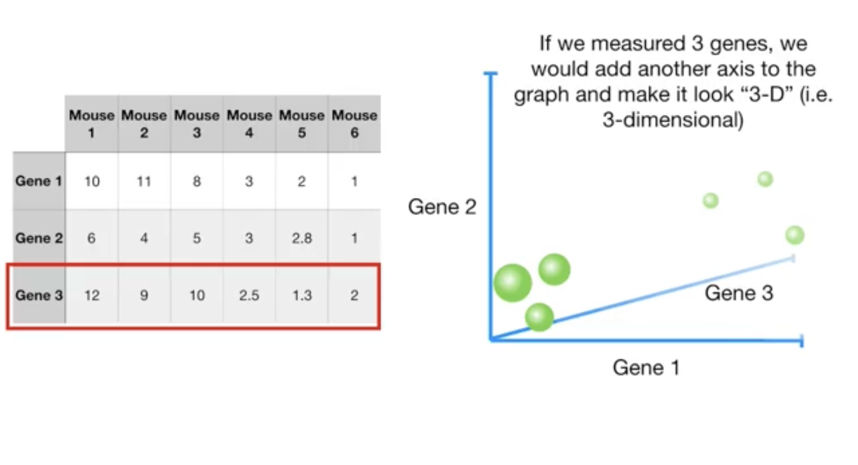

Slide 10
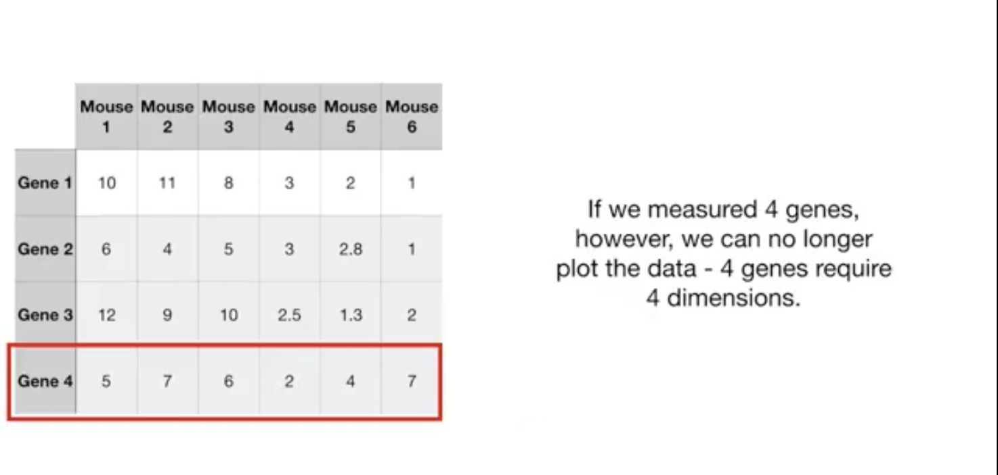

Slide 11
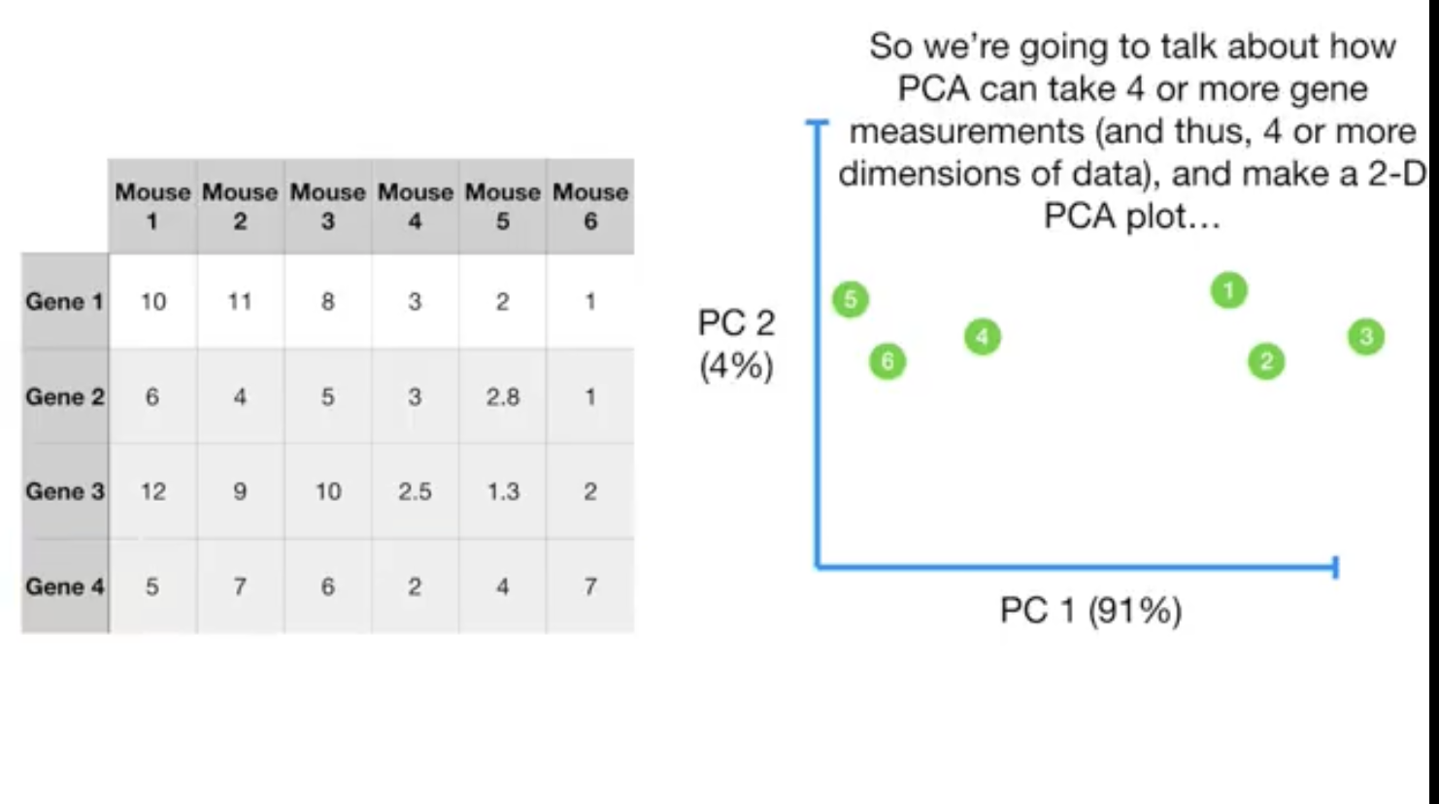

Slide 12
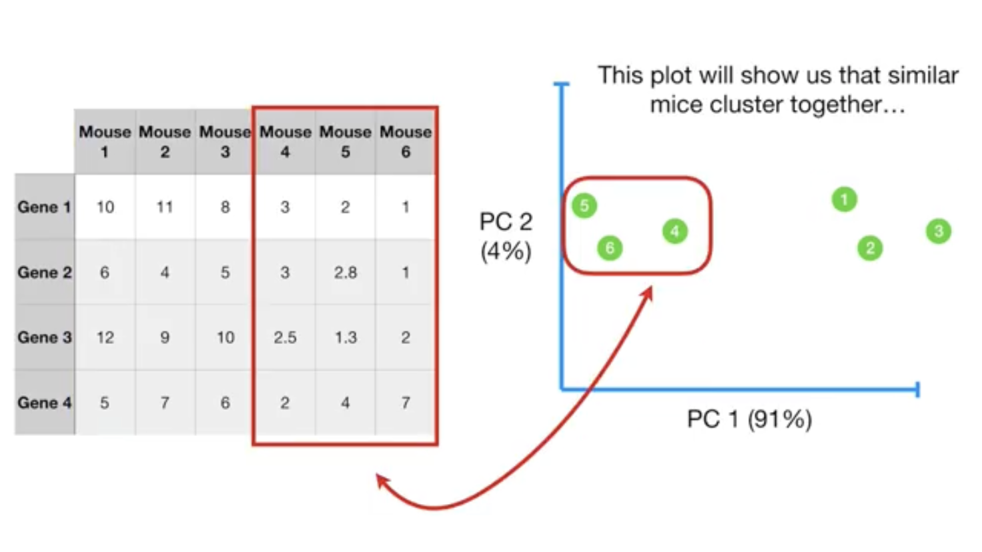

Slide 13
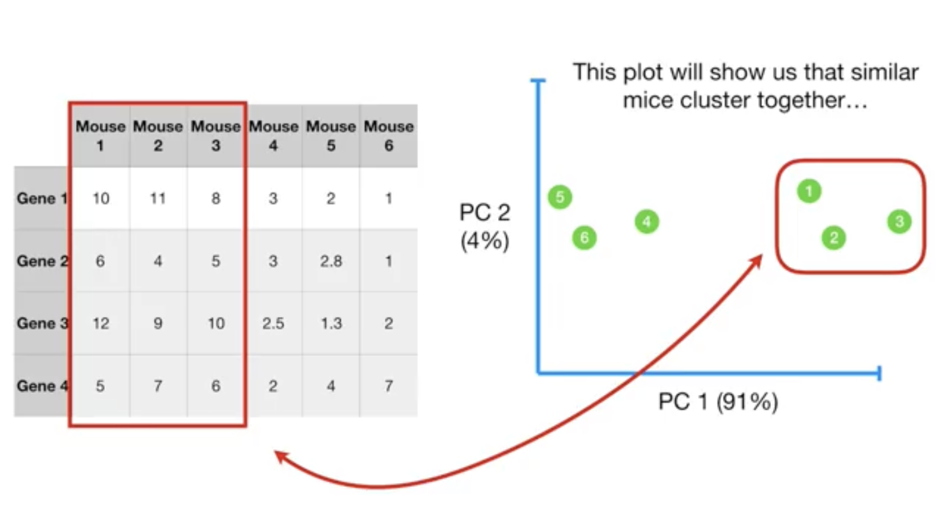

Slide 14
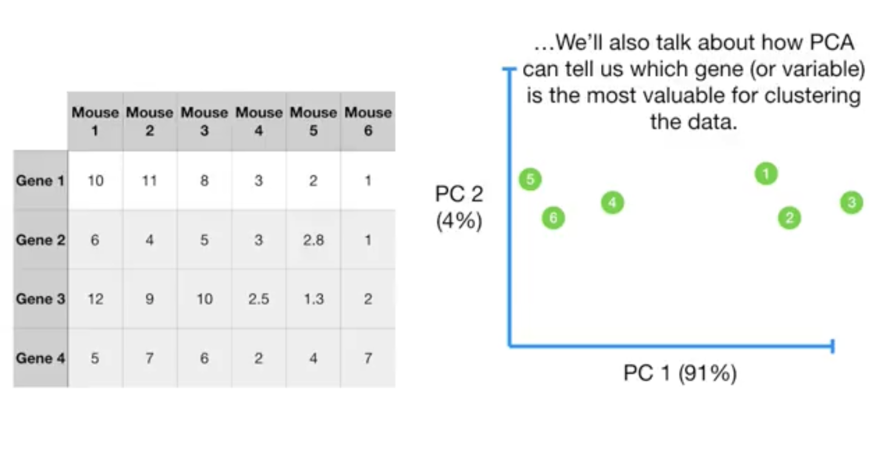

Slide 15
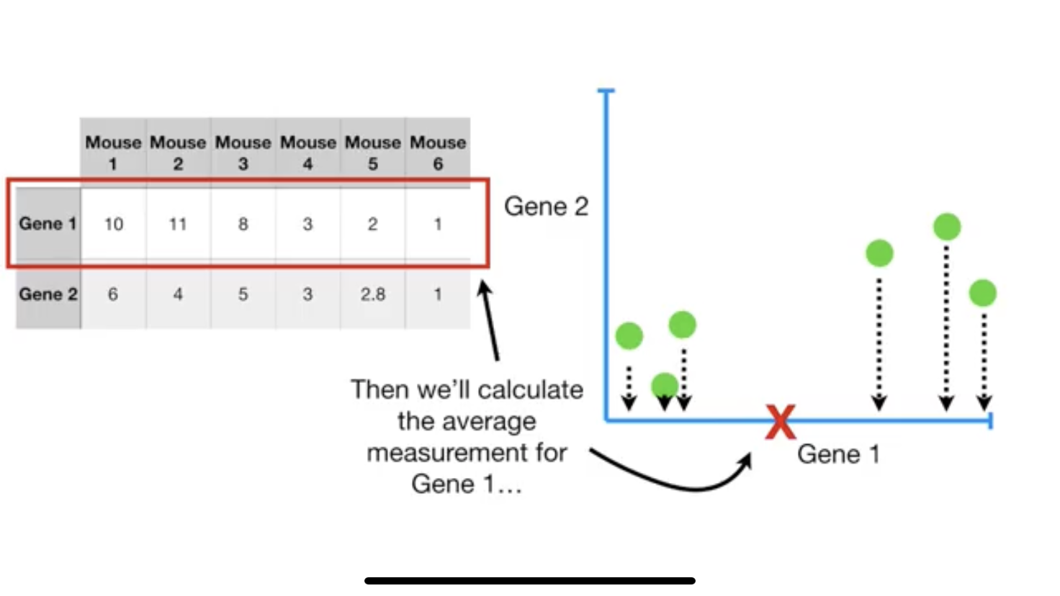

Slide 16
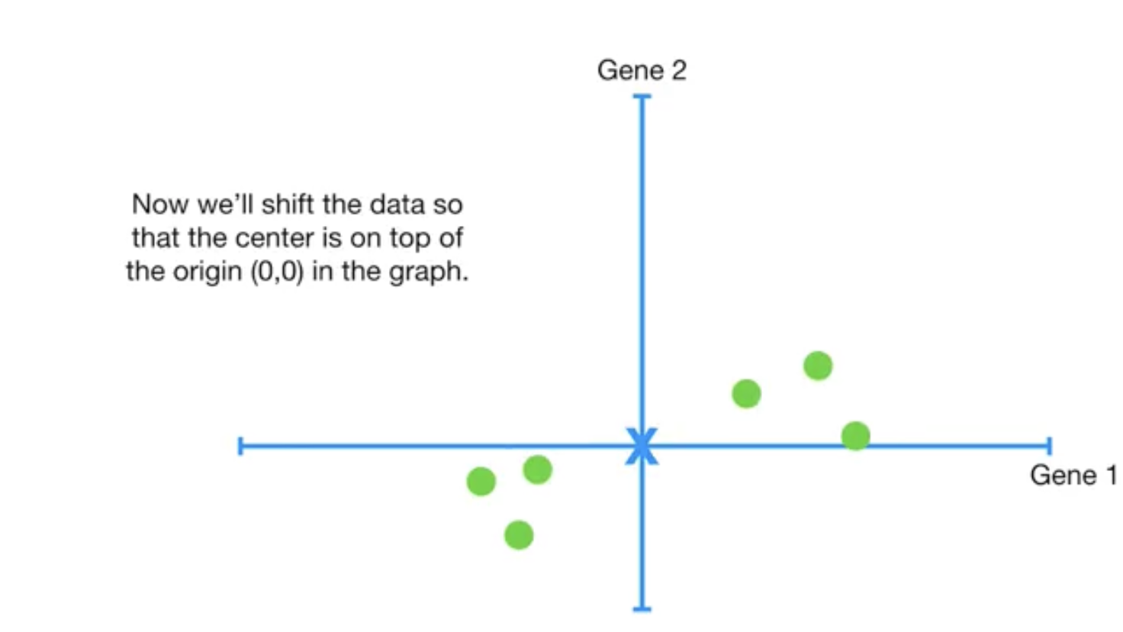

Slide 17
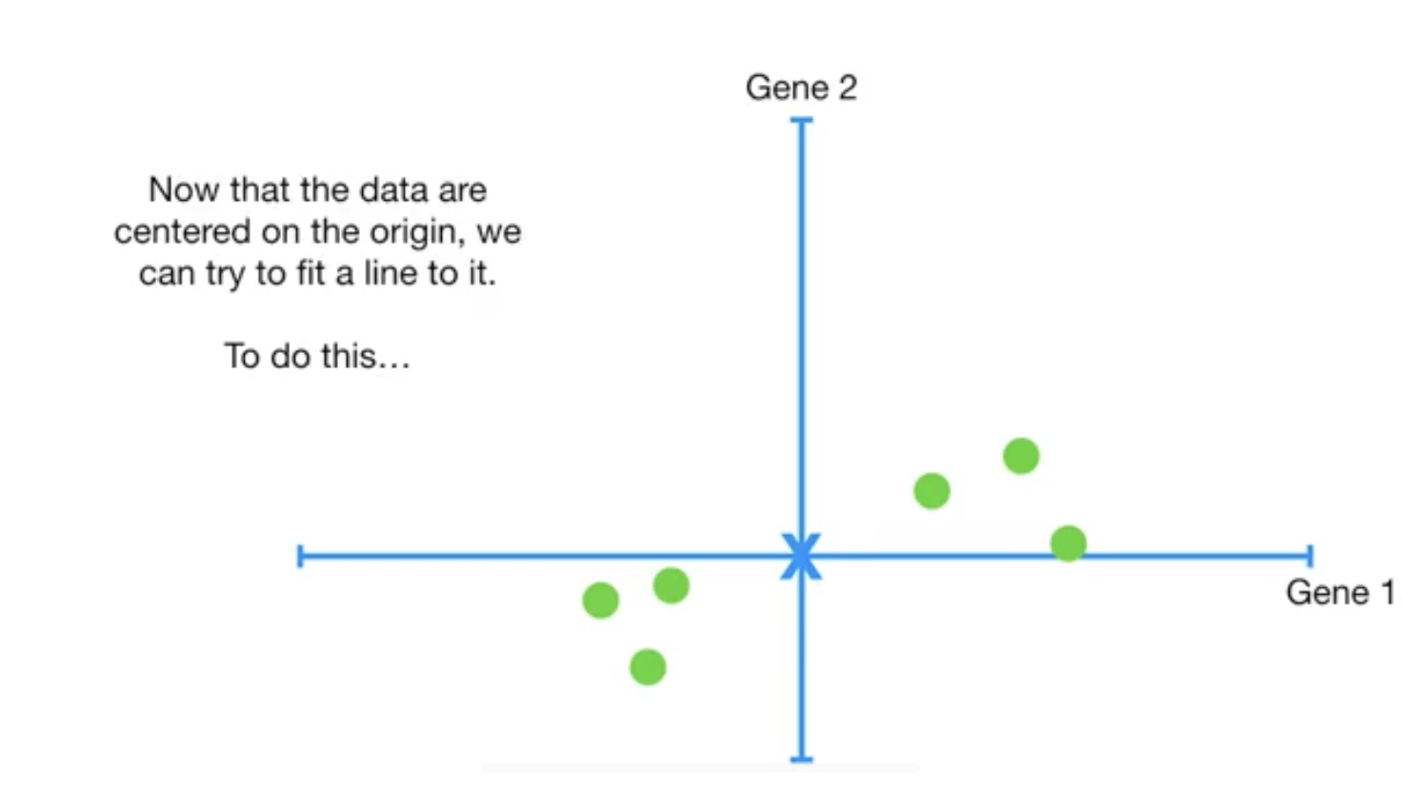

Slide 18
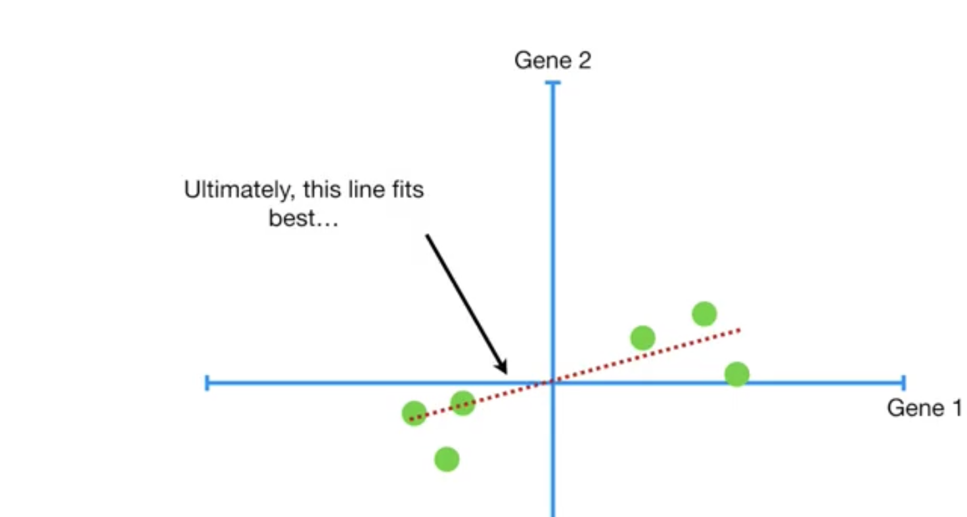

Slide 19
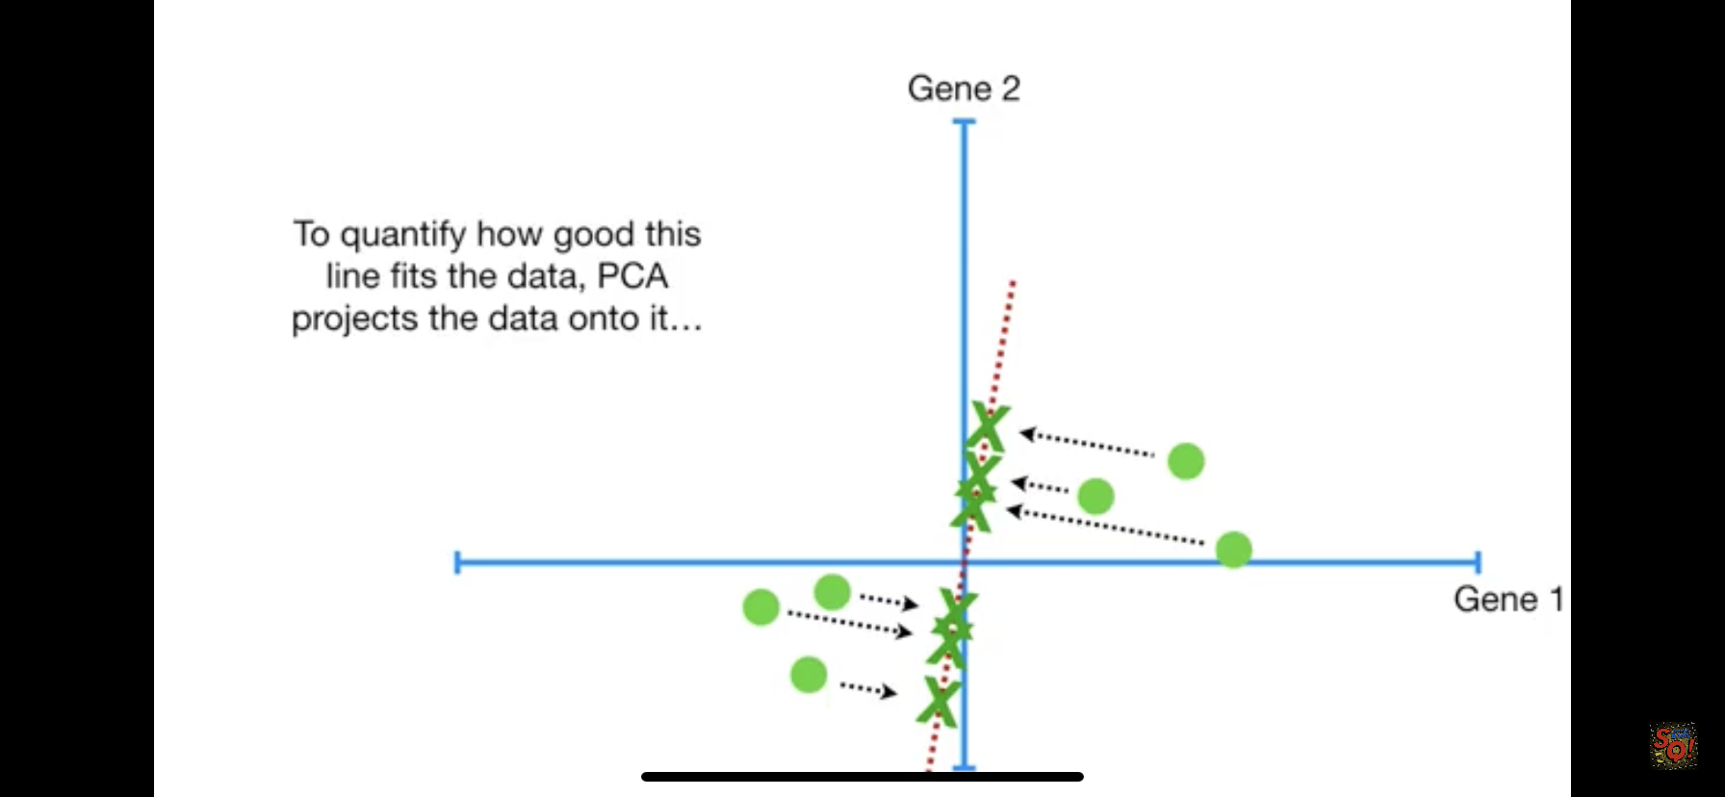

Slide 20
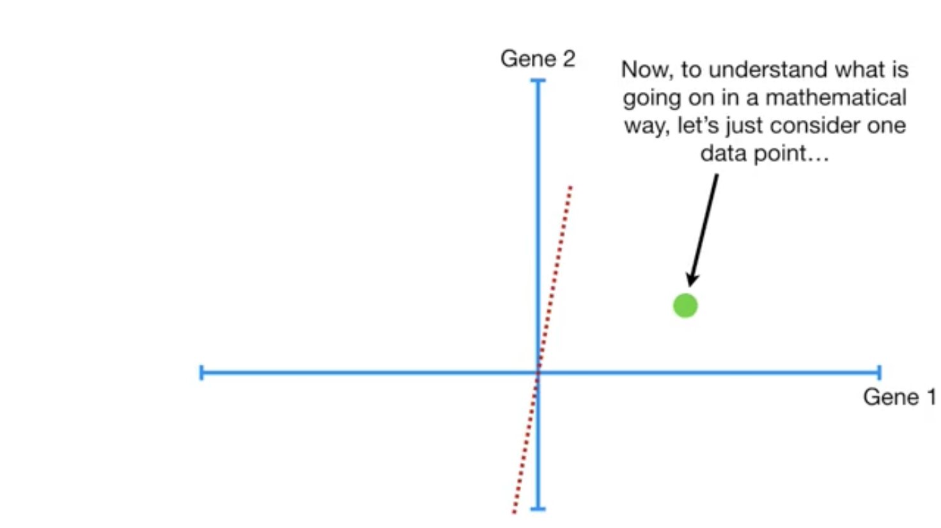

Slide 21
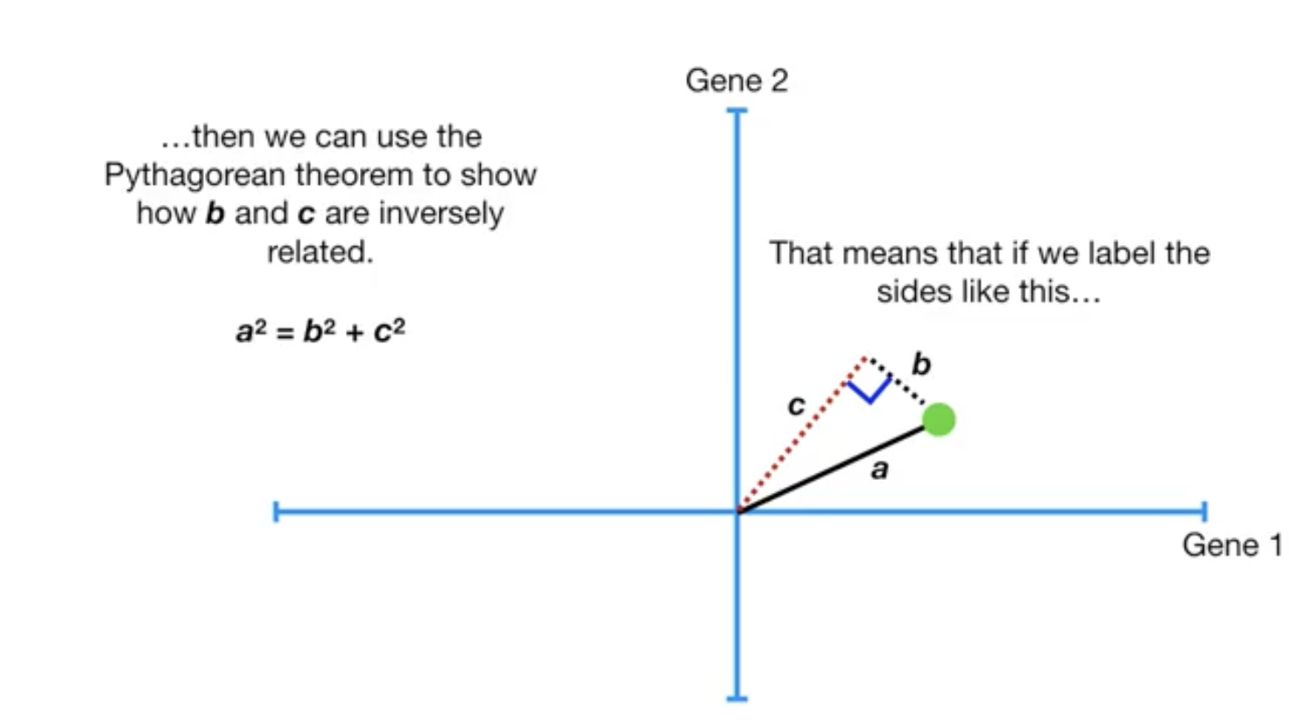

Slide 22
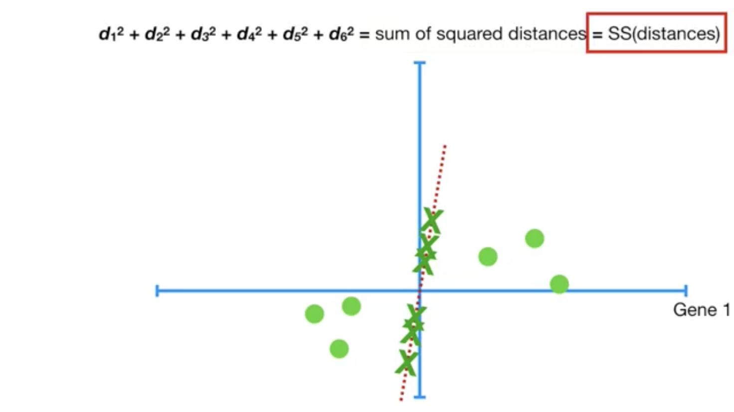

Slide 23
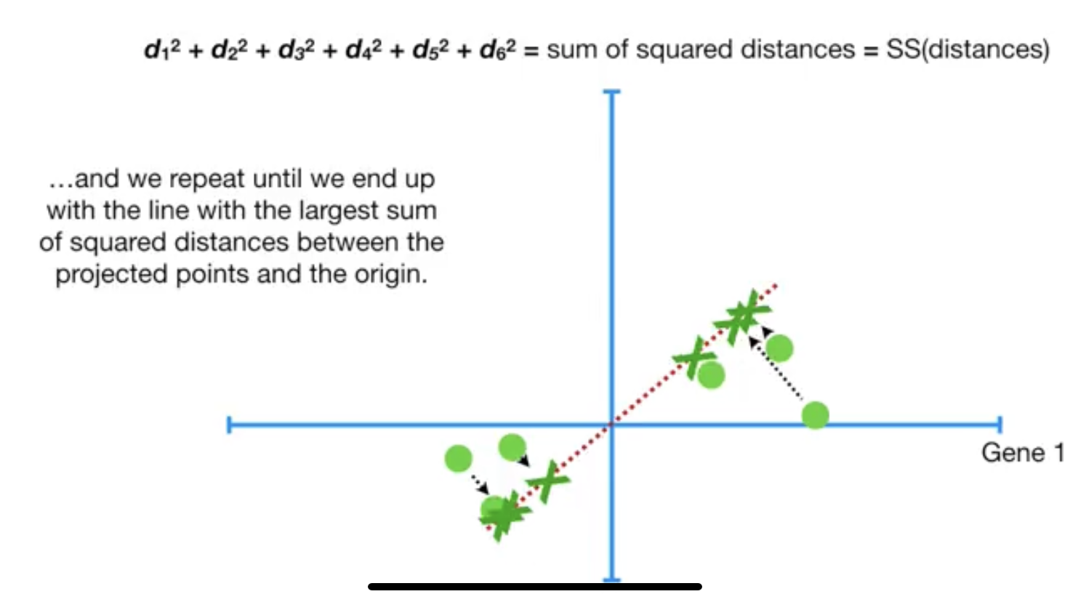

Slide 24
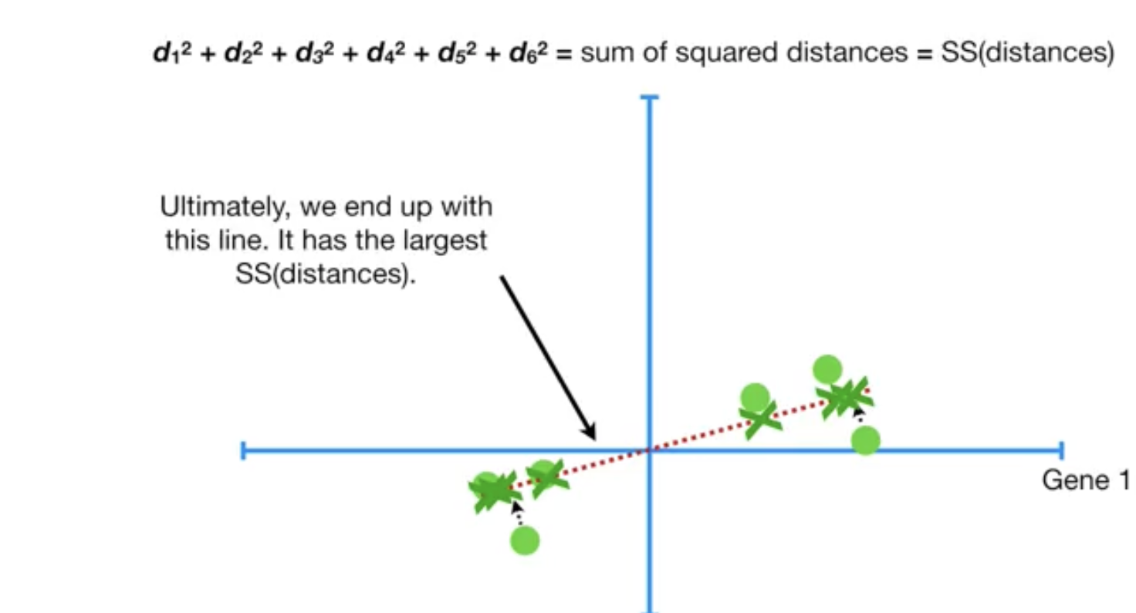

Slide 25
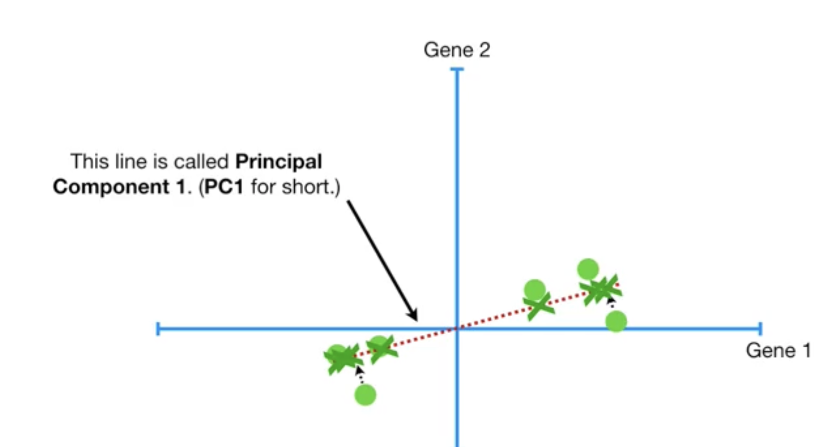

Slide 26
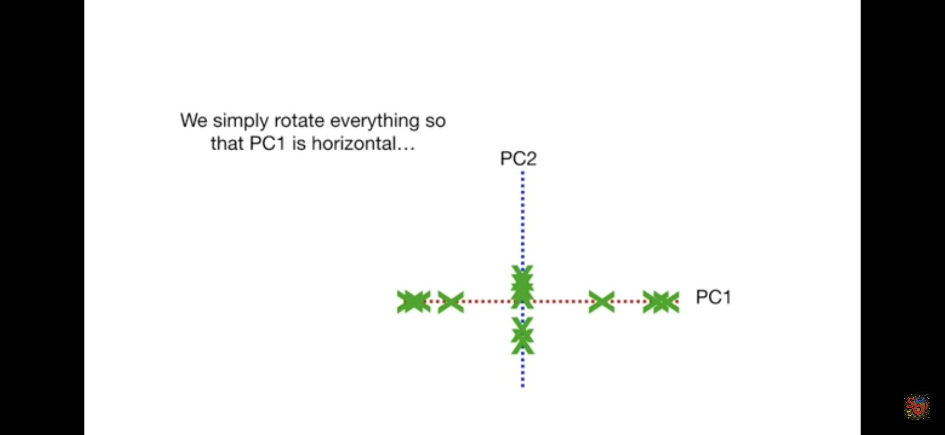

Slide 27


